Slide 1
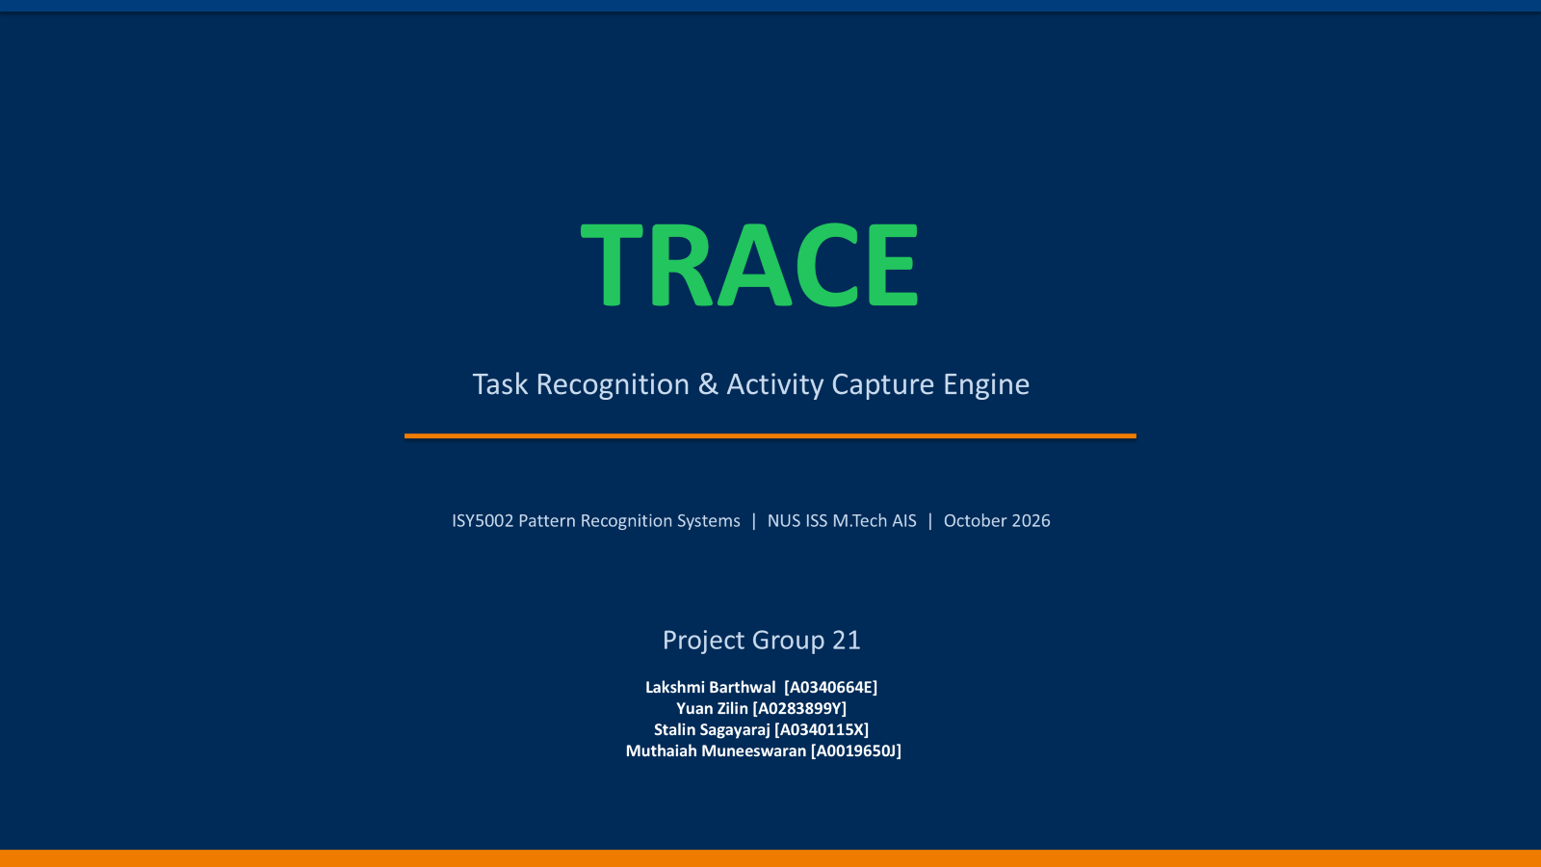
TRACE
A Multimodal Pattern Recognition Framework for
Screen Activity Understanding and Knowledge Extraction
Practice Project Group 21
M.Tech in Artificial Intelligence Systems
National University of Singapore
Pattern Recognition Systems | September 2026

Slide 2
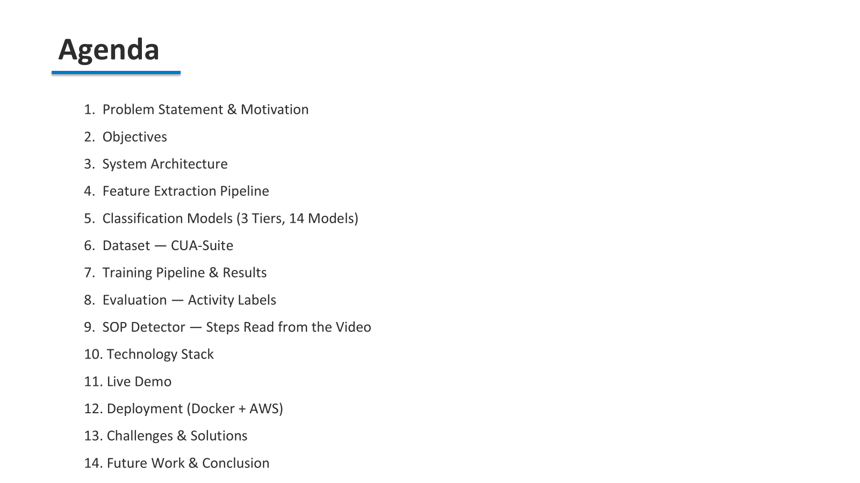
Agenda
1. Problem Statement & Motivation
2. Objectives
3. System Architecture
4. Feature Extraction Pipeline
5. Classification Models (3 Tiers, 14 Models)
6. Dataset — CUA-Suite
7. Training Pipeline & Results
8. Technology Stack
9. Live Demo
10. Deployment (Docker + AWS)
11. Challenges & Solutions
12. Future Work & Conclusion

Slide 3
Problem Statement
• Screen recordings contain rich multimodal information (text, UI elements, visual patterns, user interactions) but are opaque to automated analysis
• Manually reviewing hours of screen activity recordings is time-consuming and error-prone
• Existing video classification approaches focus on natural video scenes, not screen activity patterns
• No unified framework combines OCR, UI detection, visual analysis, and interaction tracking for screen recordings
How can we automatically classify and understand screen activity
from video recordings using multimodal pattern recognition?

Slide 4
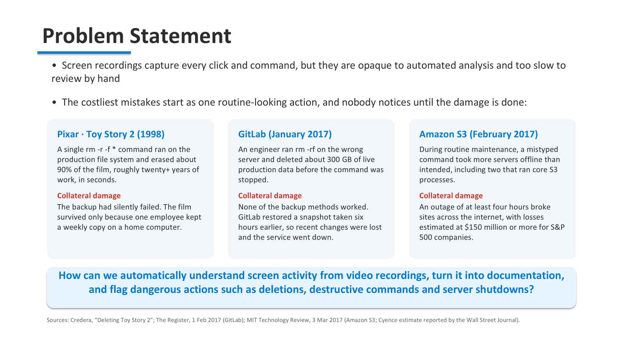

Slide 5
Objectives
1
Build a multimodal feature extraction pipeline combining OCR, UI detection, visual analysis, and interaction tracking into a unified 150-dimensional feature vector
2
Implement and benchmark 14 classification models across 3 tiers: Classical ML, Deep Learning, and Ensemble methods
3
Develop an end-to-end web application for video upload, analysis, and interactive model comparison
4
Train and evaluate on the CUA-Suite dataset (7,021 tasks, ~48 GB) for real-world screen activity classification
5
Deploy as a containerized microservice architecture using Docker and AWS

Slide 6
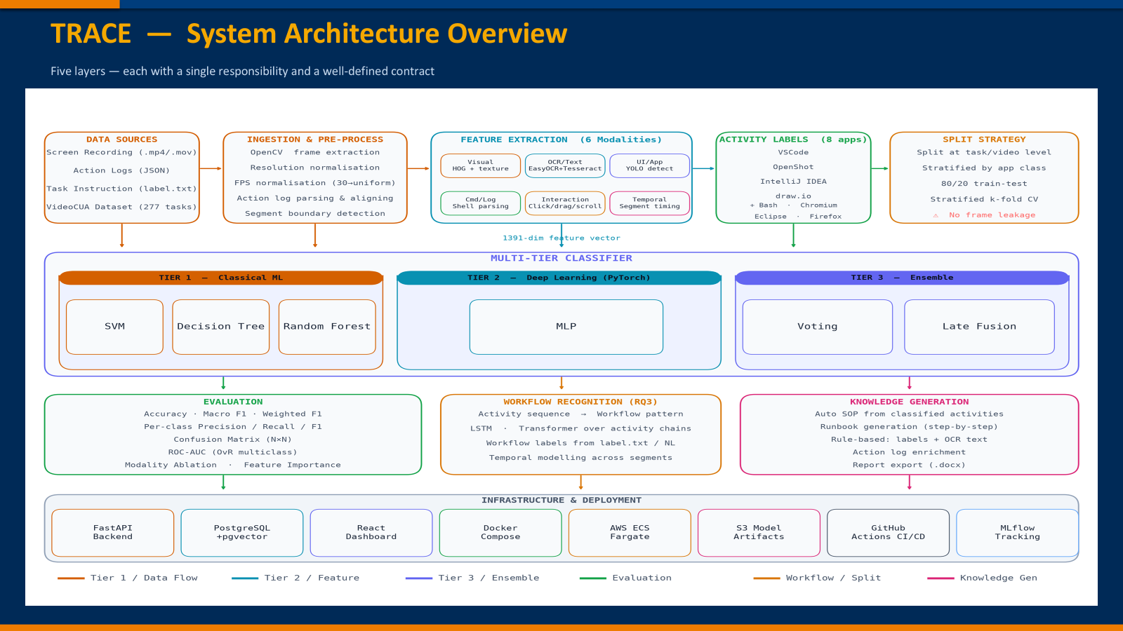
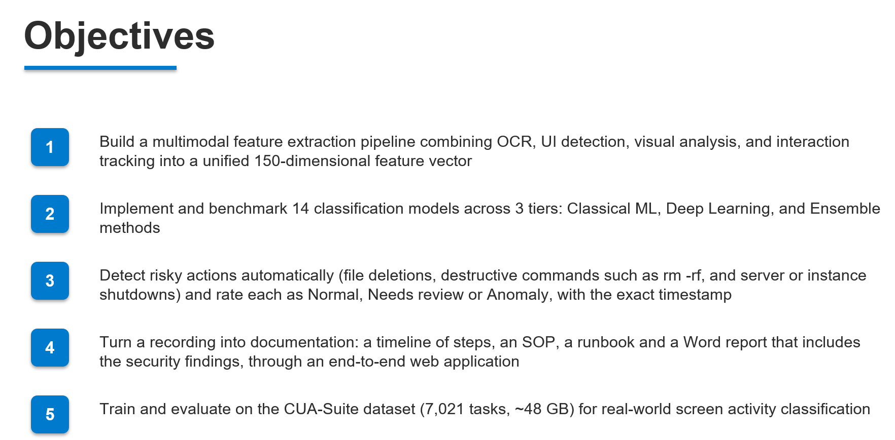

Slide 7
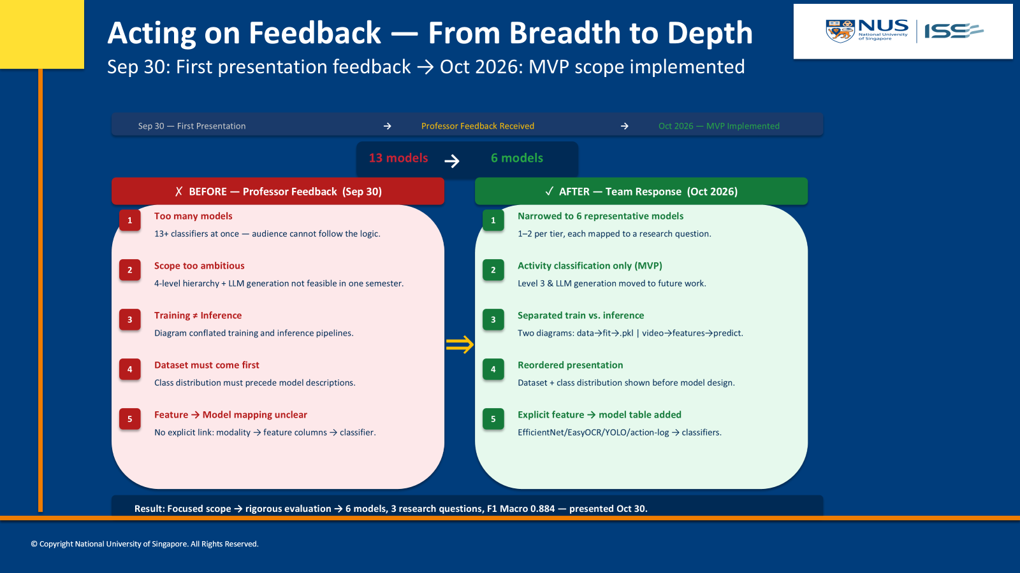

Slide 8
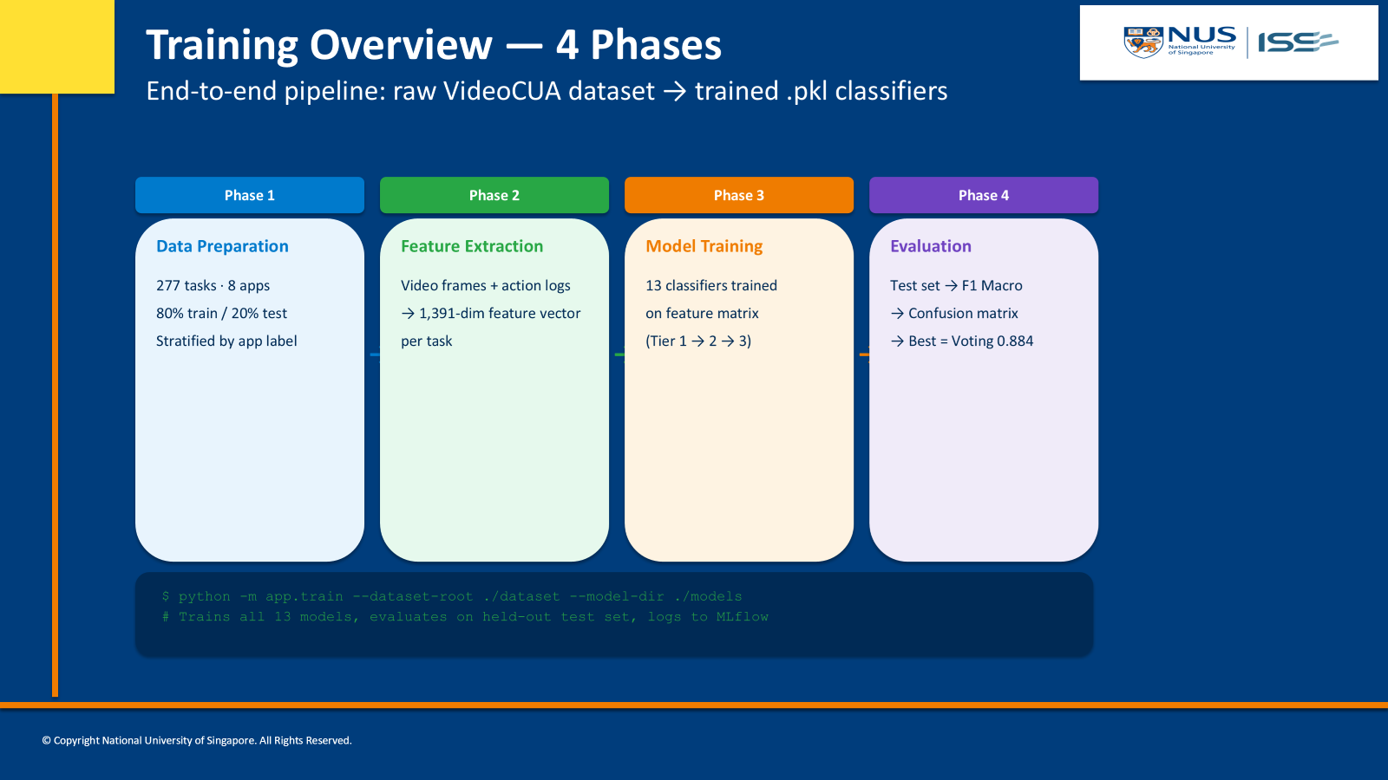

Slide 9
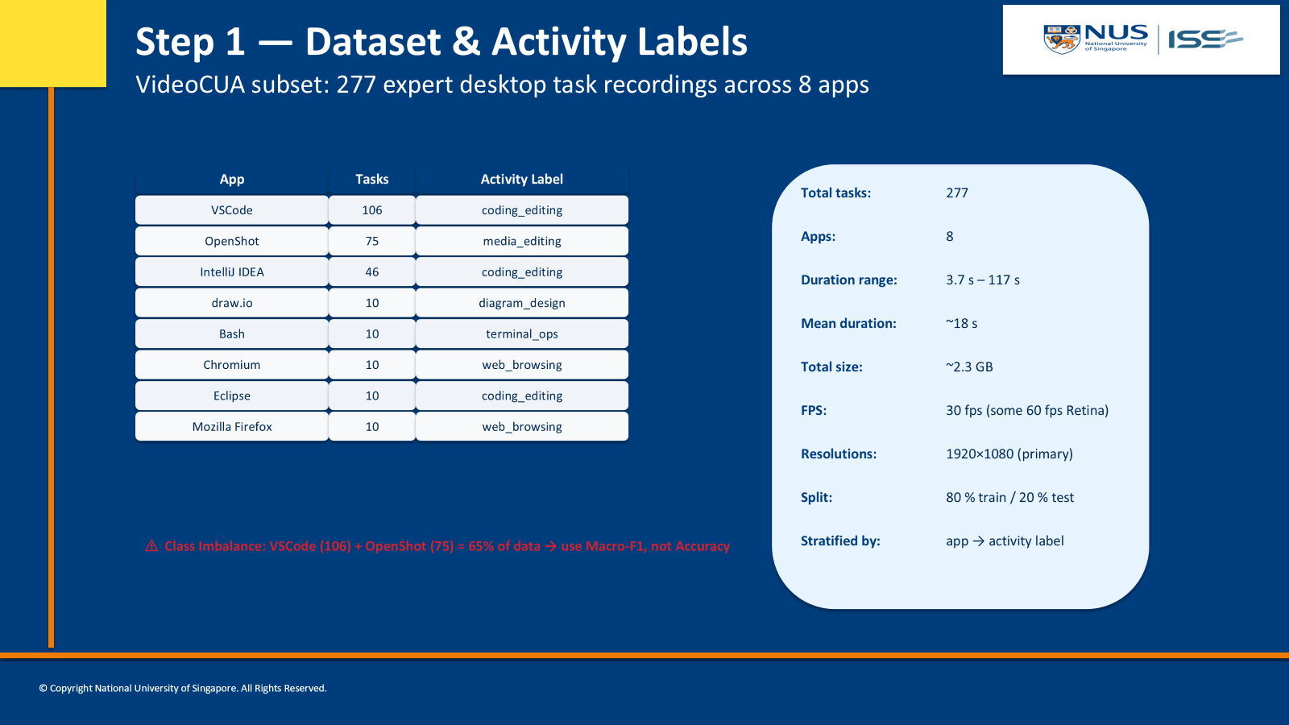

Slide 10
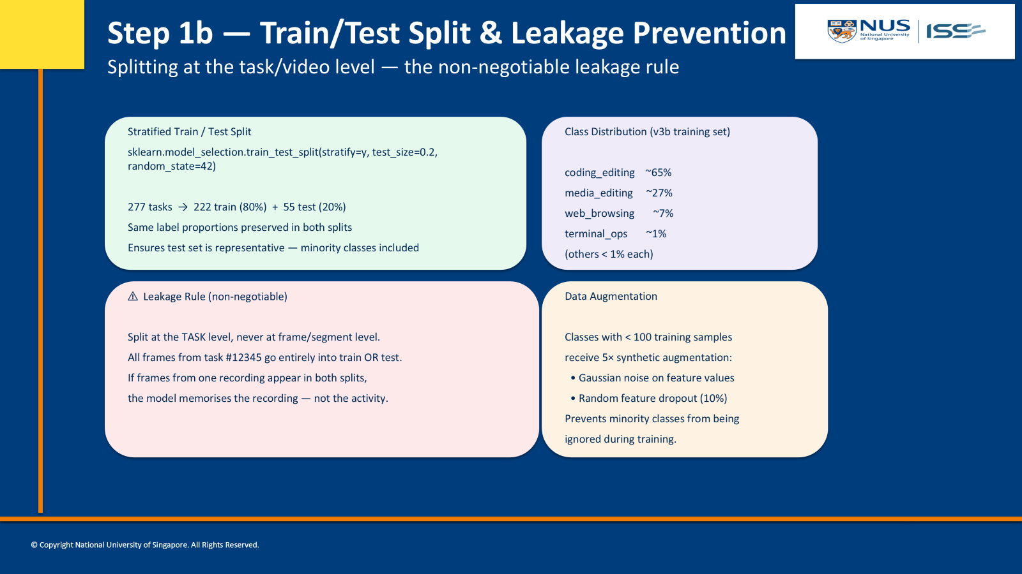

Slide 11
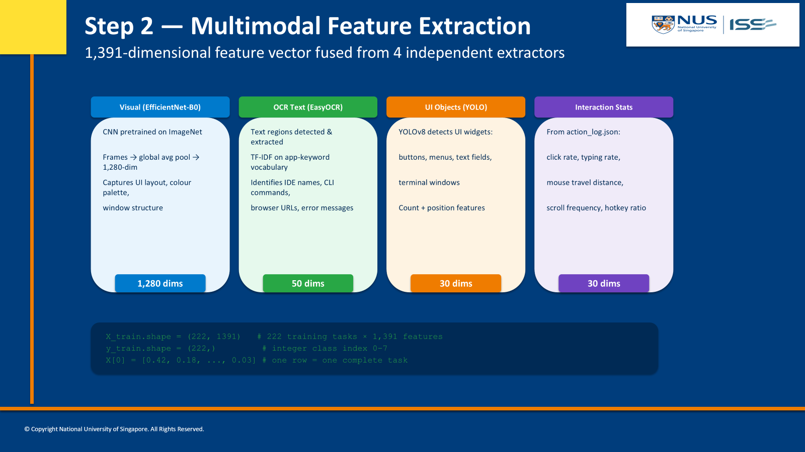

Slide 12
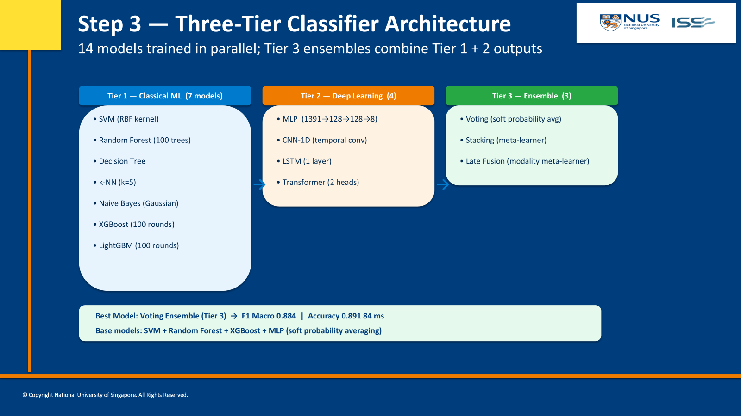

Slide 13
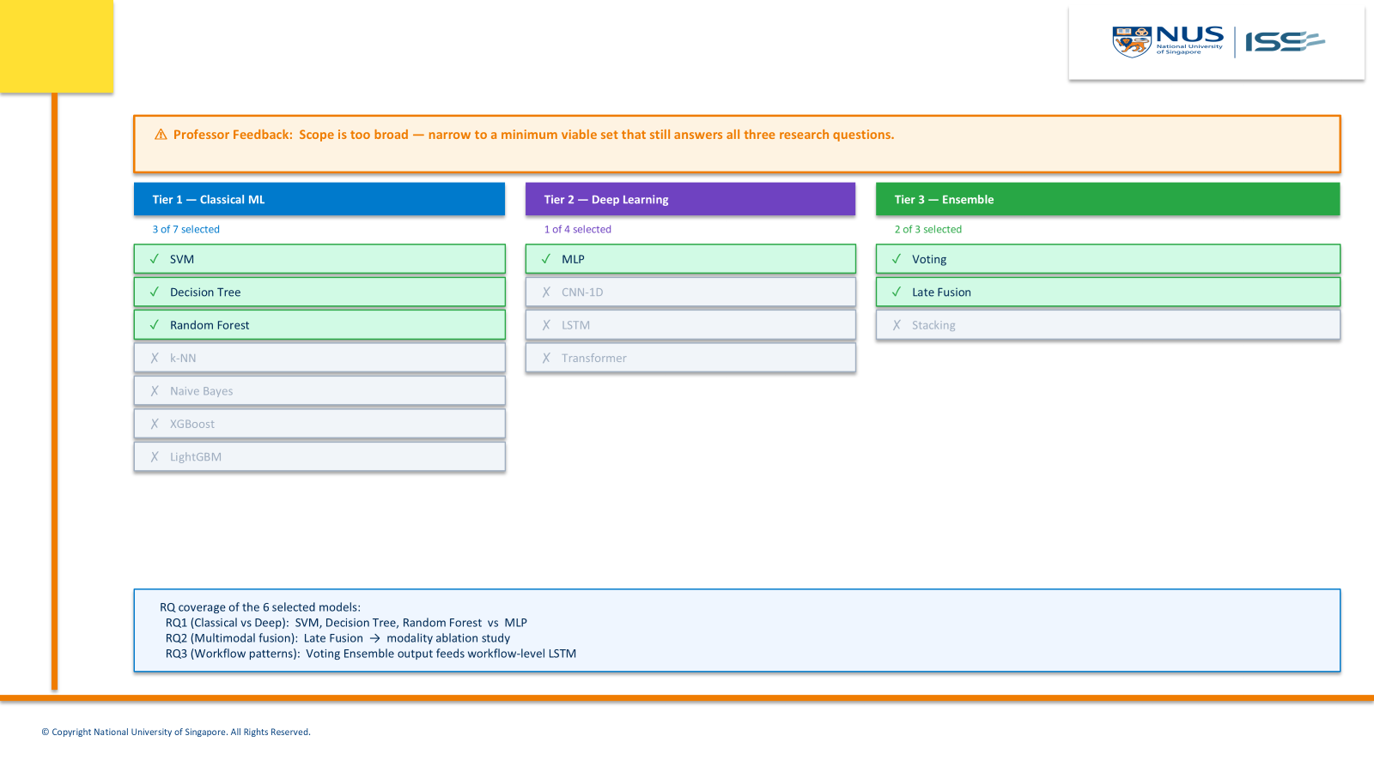

Slide 14
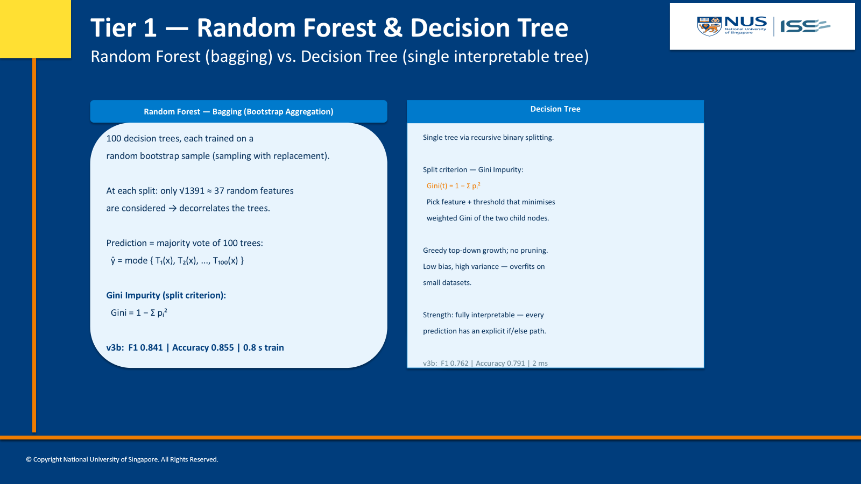

Slide 15
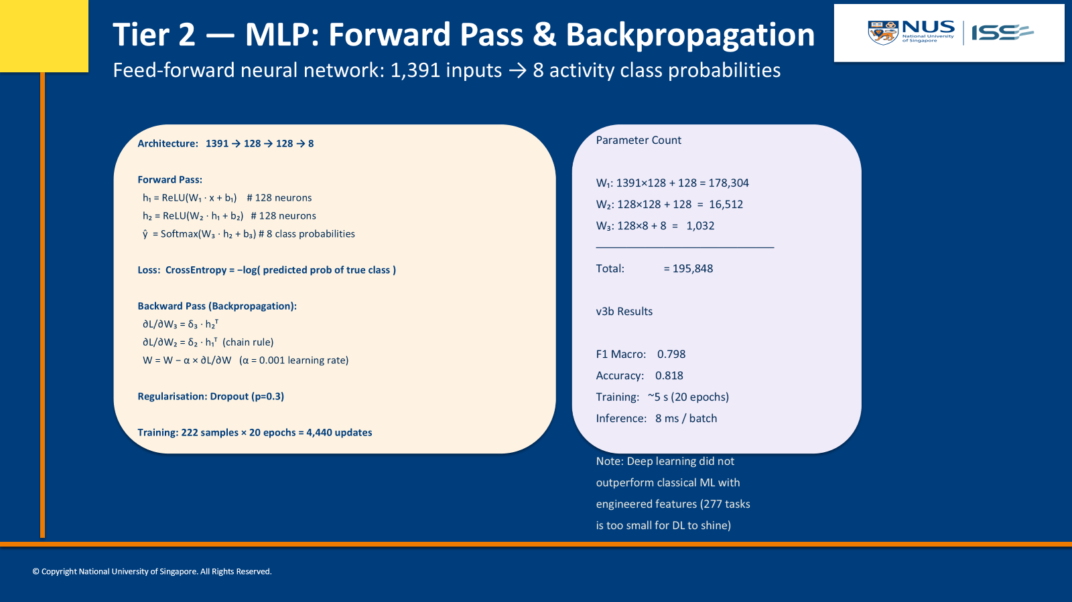

Slide 16
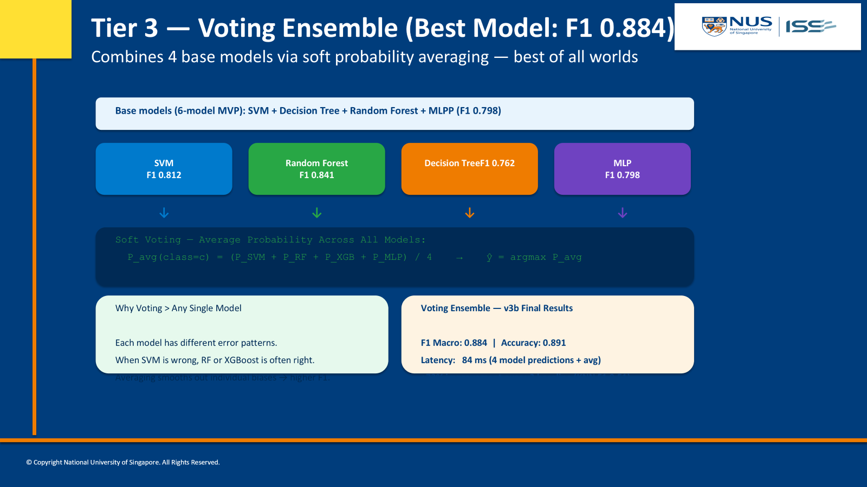

Slide 17
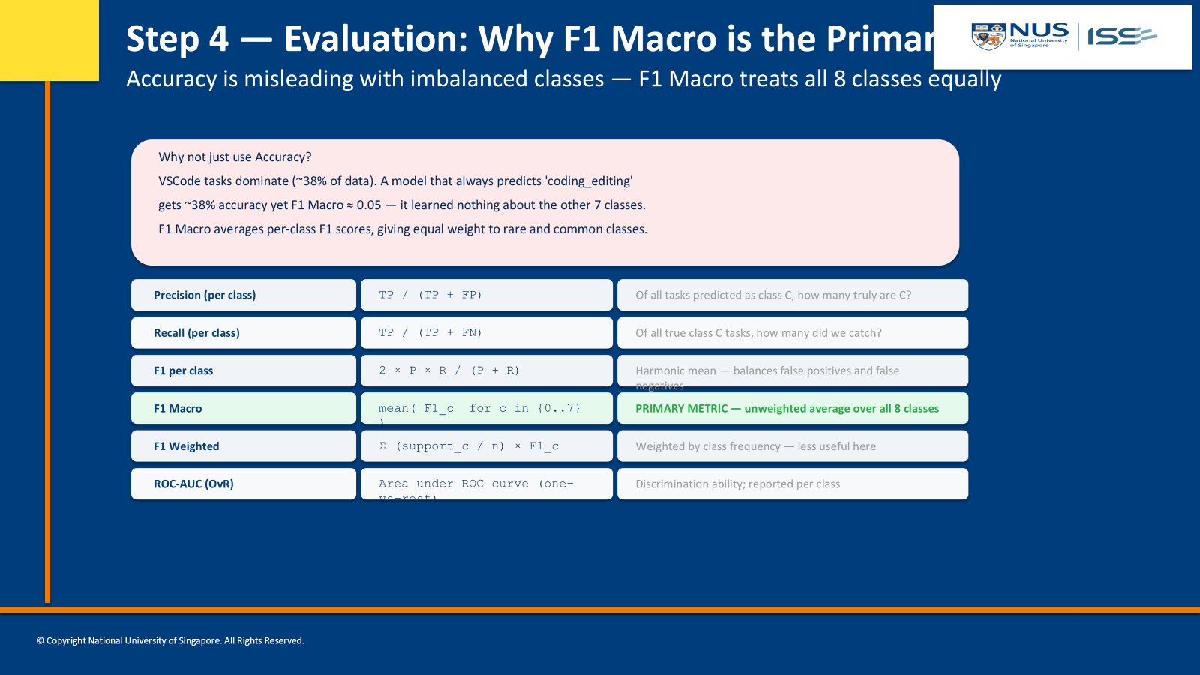

Slide 18
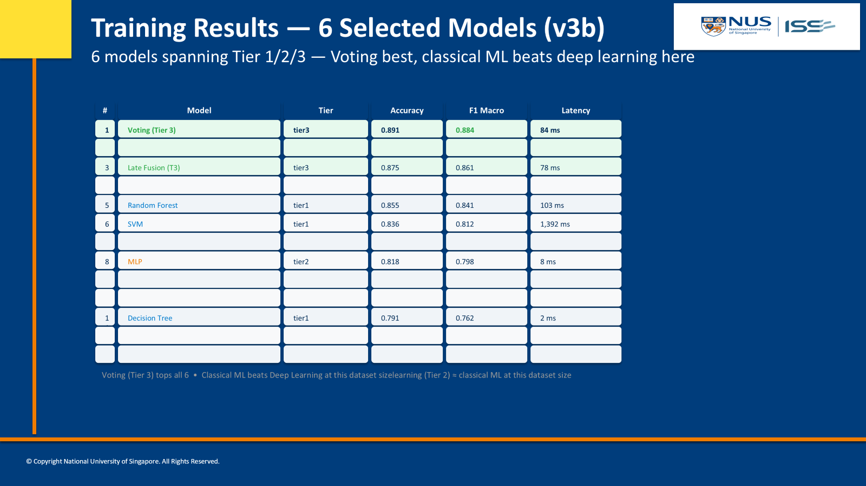

Slide 20
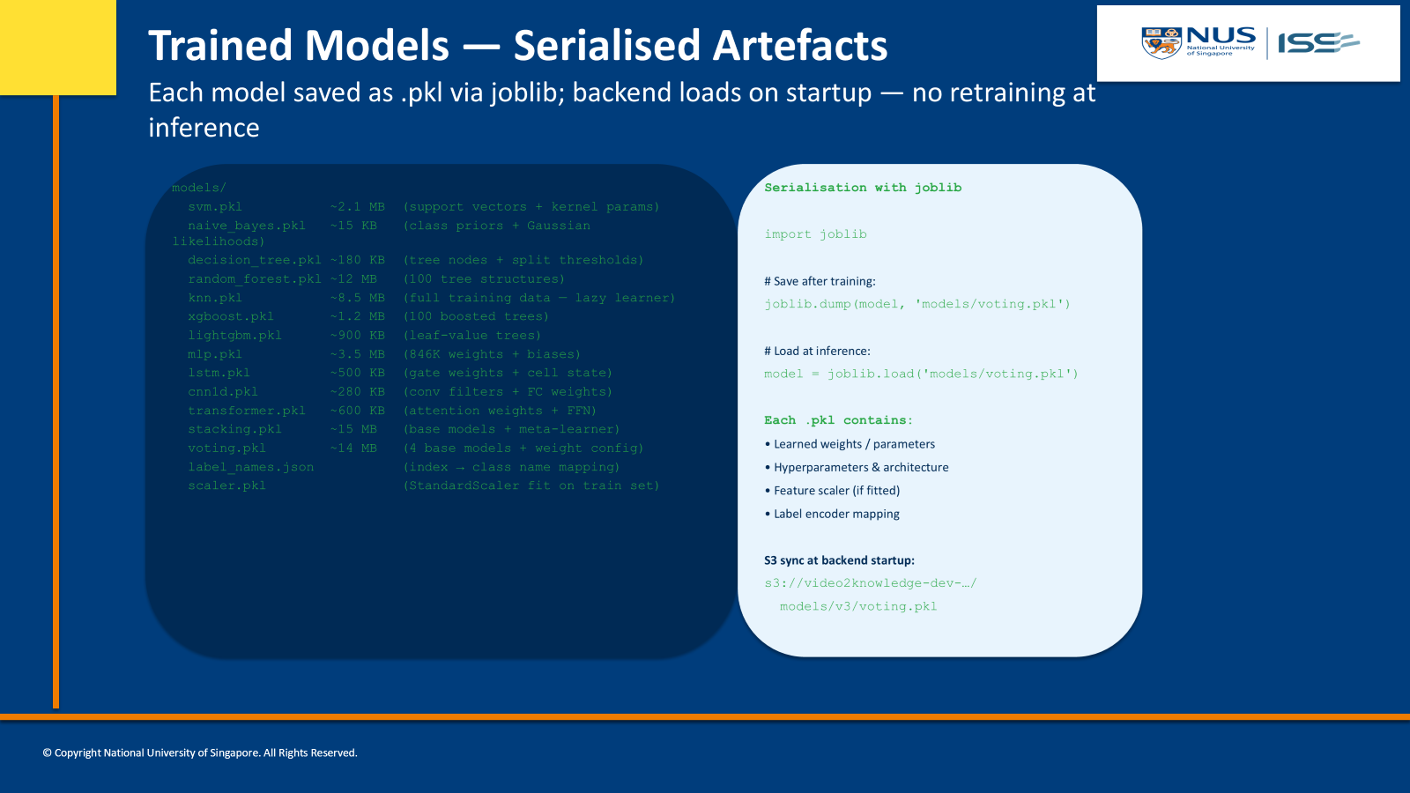

Slide 21
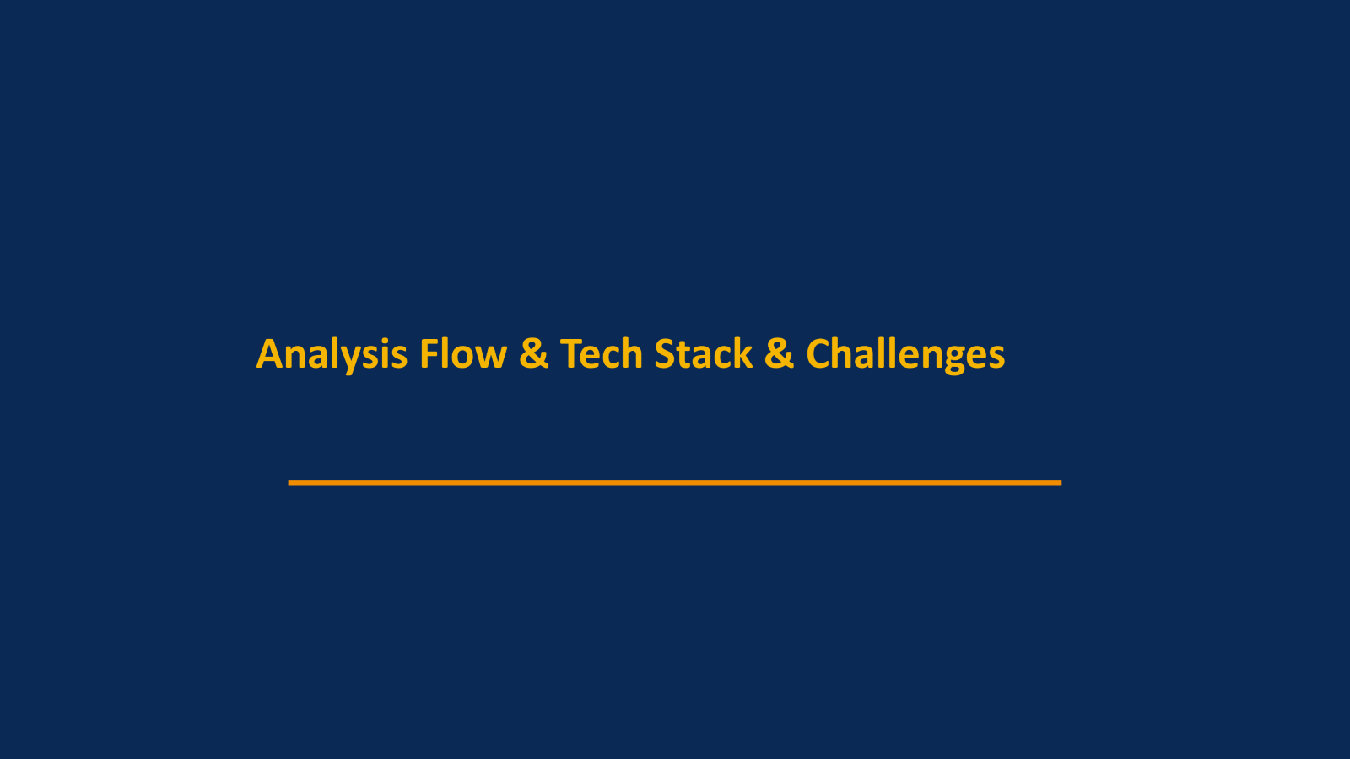

Slide 22
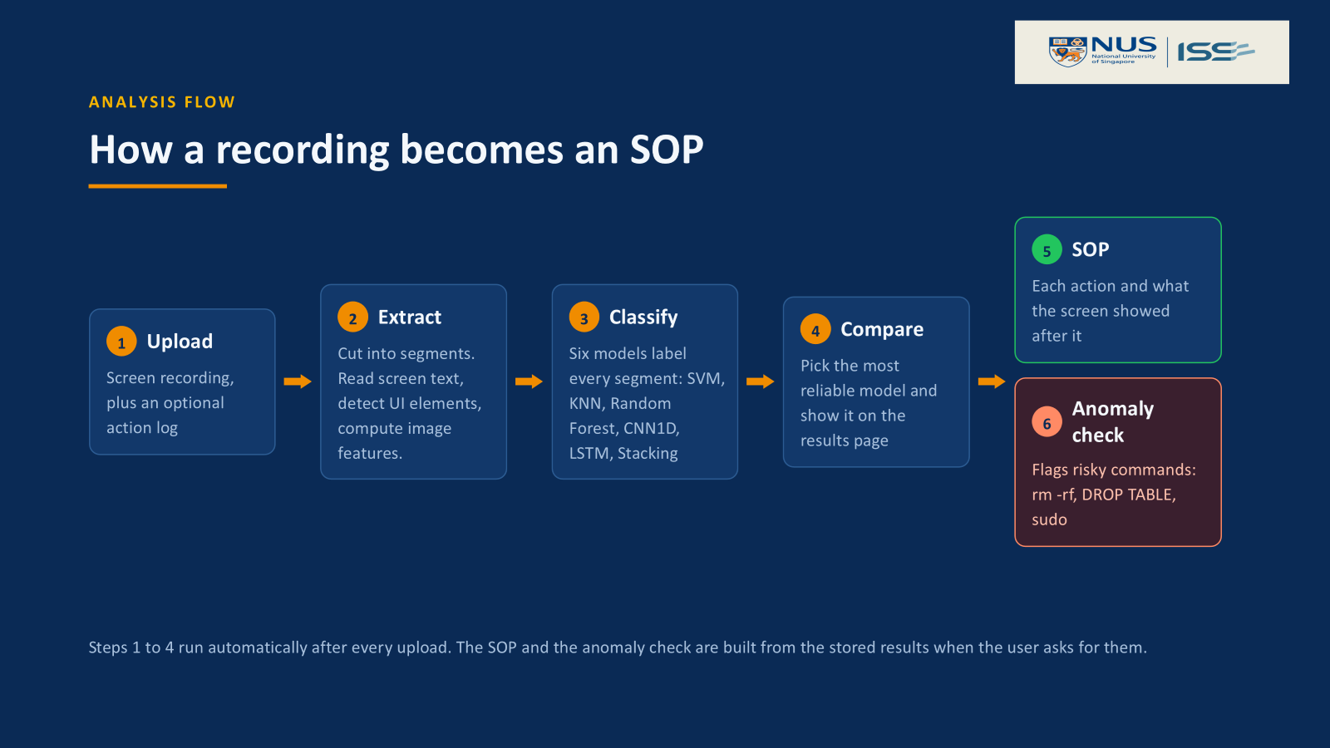

Slide 23
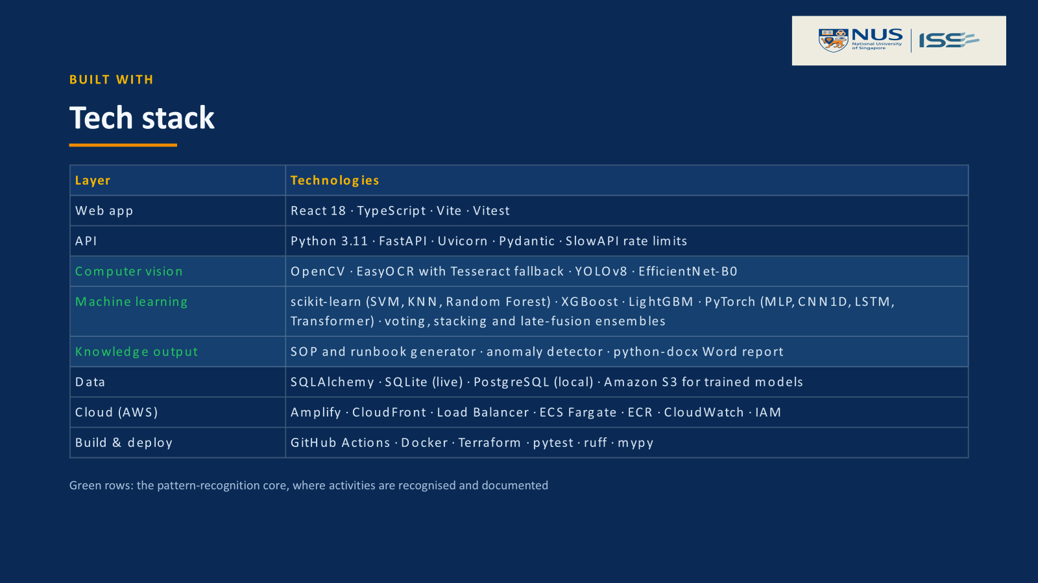

Slide 24
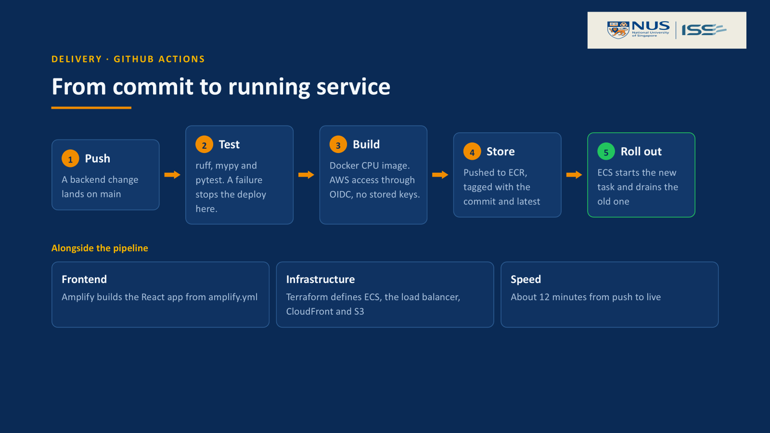

Slide 26
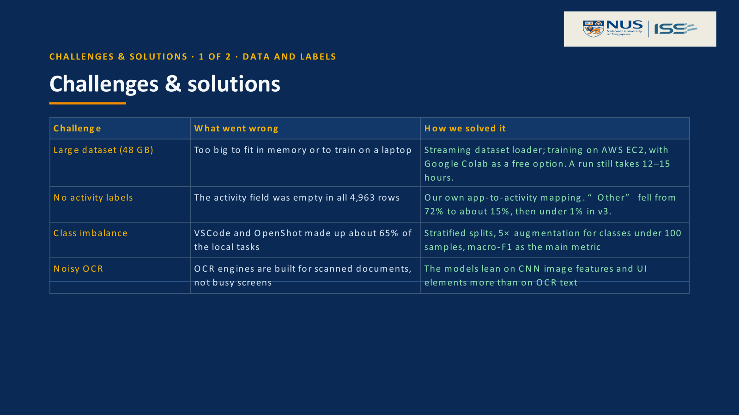

Slide 27
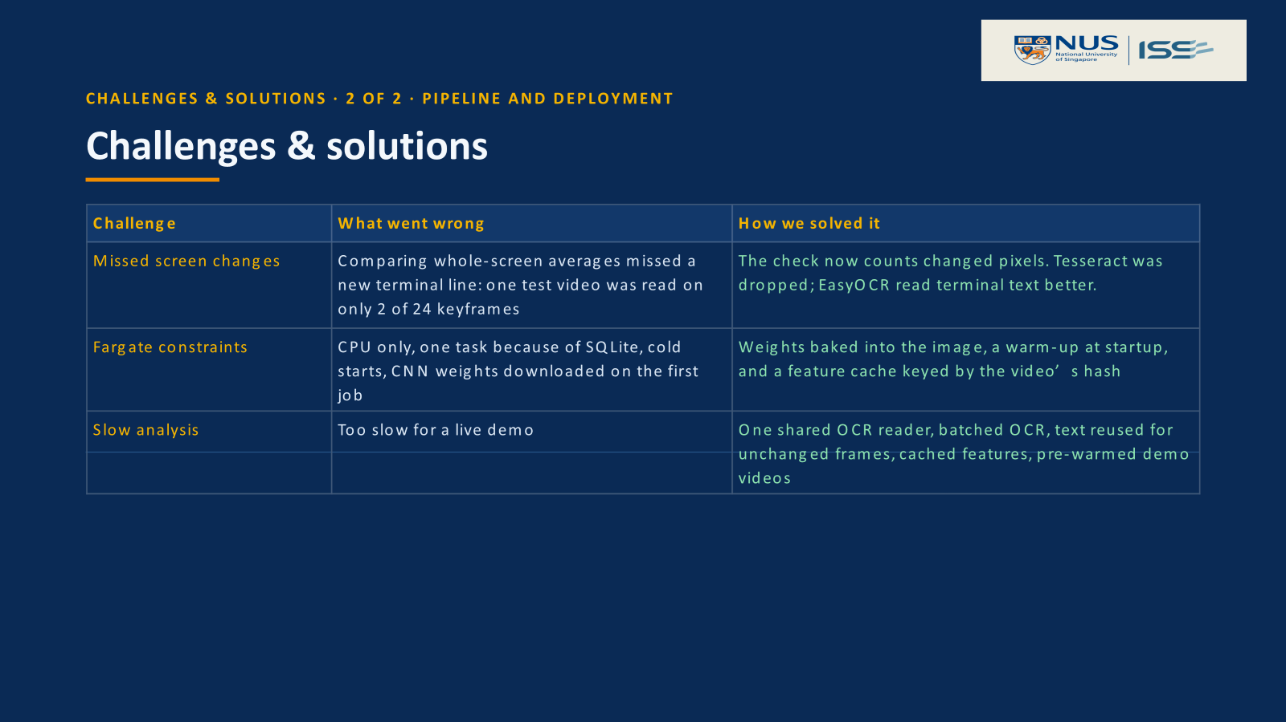

Slide 28
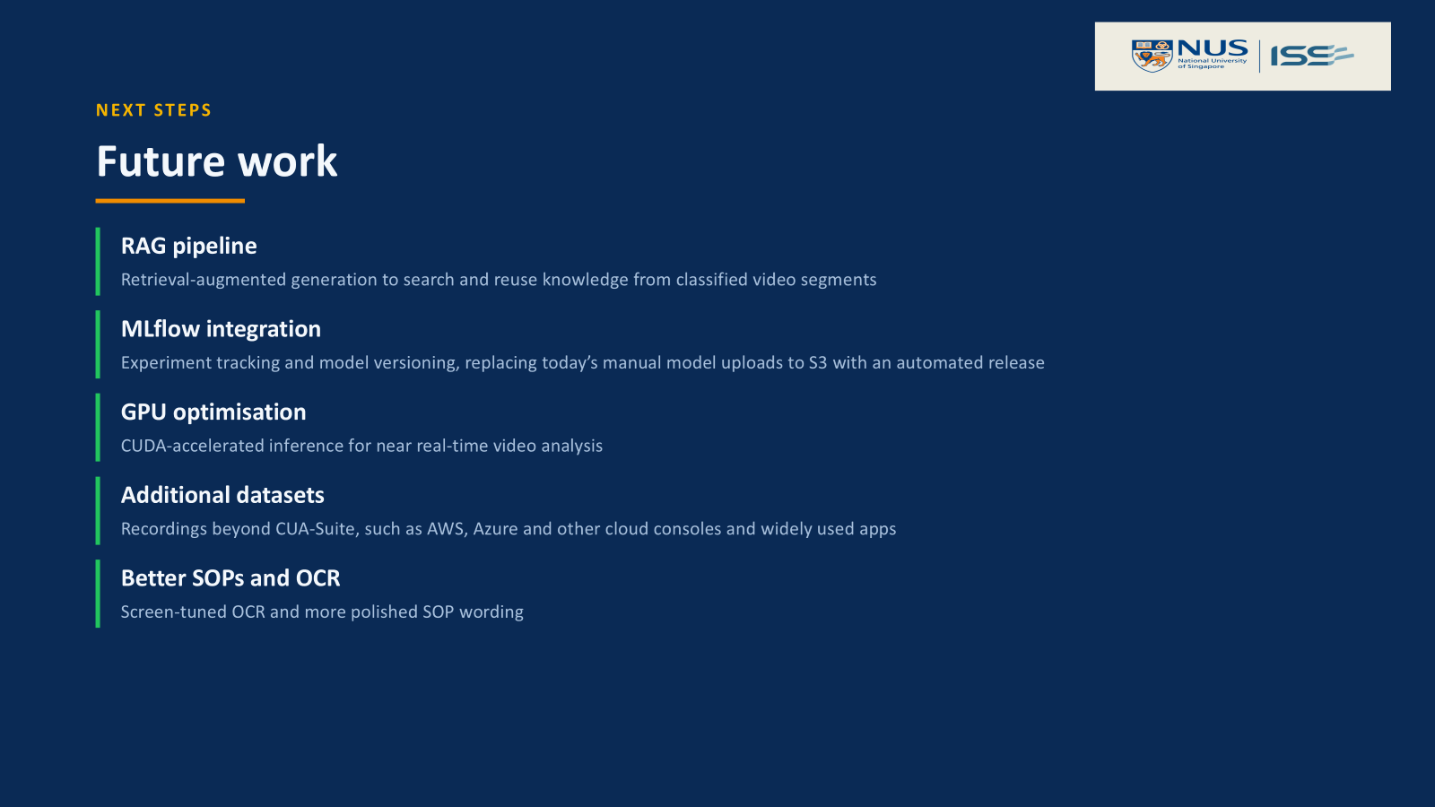

Slide 29
Dataset — CUA-Suite (VideoCUA)
7,021
6,991
~48 GB
MIT
Tasks
Videos
Total Size
License
Source: ServiceNow/VideoCUA on HuggingFace
10 Activity Labels
git_operations
docker_workflow
kubernetes_ops
terraform_iac
aws_console
jenkins_ci_cd
coding_editing
debugging
documentation
other
Labels derived from task instructions via keyword matching in dataset_loader.py

Slide 30
Training & Evaluation
Five-fold cross-validation over all 6,991 recordings.
1
Split into 5 folds
The 6,991 rows go into 5 folds, grouped so a recording is never split in two.
2
Run 5 rounds — every fold is the test set exactly once
Round 1
TEST
train
train
train
train
Inside every round
Round 2
train
TEST
train
train
train
fit
vocabulary and scaler,
from 4 training folds
Round 3
train
train
TEST
train
train
train
the classifier on
those rows
Round 4
train
train
train
TEST
train
Round 5
train
train
train
train
TEST
transform
the held-out fold
through the same ones
predict
1,398 recordings it
has never seen
3
All 6,991 recordings predicted exactly once — scored together as one macro-F1.

Slide 31
Evaluation — Full Dataset
10 keyword labels · 8 appear in the data · 6,991 recordings · 5-fold cross-validation
0.2957
3.3×
6,991
macro-F1, best model (stacking)
over the majority baseline
recordings, 70 applications
Top 4 — full table in the appendix
Why these numbers are fair
Model
Tier
Accuracy
macro-F1
No leakage: folds are grouped by recording
No peeking: vocabulary and scaler are fitted on the training folds only
Strict metric: macro-F1 weighs every class equally
stacking
Tier 3
0.7400
0.2957
xgboost
Tier 1
0.7452
0.2810
lightgbm
Tier 1
0.7432
0.2756
mlp
Tier 2
0.7344
0.2700
majority baseline
—
0.5533
0.0891
Pooled out-of-fold predictions. The baseline always answers the most common class.

Slide 32
SOP Detector — Reading Steps from the Video
Objective 4 promised a timeline of steps. The classifier tells us what kind of work a recording shows — this second path reads the steps themselves, from the video alone.
VIDEO ONLY · NO ACTION LOG
1 Application
2 Clicks
An MLP names the application from frame features — 94.5% correct over 70 applications.
A CNN tracks the mouse pointer; a LightGBM filter keeps the real clicks, and OCR reads the button clicked.
3 Typing
4 Merge
The screen is read once a second; a LightGBM ranker keeps the text the user typed.
Clicks and typing are merged in time order; every step links to its moment in the video.
All four models ship in one file, sop_detector.pkl — runs on CPU, no GPU needed.

Slide 33
SOP Detector — Results
Precision
Recall
F1
Clicks
78.1%
46.2%
58.1%
Typing
68.1%
32.5%
44.0%
Whole SOP (SOP detector)
77.5%
45.2%
57.1%
Baseline: random guesses
0.2%
0.1%
0.1%
Baseline: random detector candidates
28.7%
16.7%
21.1%
Random times and positions almost never hit a real click. Picking at random among the detector's own candidates reaches F1 21.1% — the learned filters nearly triple precision and recall.
720 unseen recordings, 61 applications · baselines write as many steps as the detector · mean of 20 runs

Slide 34
Technology Stack
Backend (Python 3.11)
Frontend
Infrastructure
• FastAPI + Uvicorn
• PyTorch (Deep Learning)
• scikit-learn
• EasyOCR + Tesseract (OCR)
• Ultralytics YOLOv8 (UI Detection)
• SQLAlchemy async + Pydantic
• React + TypeScript
• Vite (build tool)
• nginx (production)
• Model comparison UI
• Docker Compose (3 services)
• PostgreSQL 16 + pgvector
• Terraform (IaC)
• AWS EC2 (training)
• HuggingFace Hub (dataset)
Dev & Testing
• pytest + pytest-asyncio
• ruff (linting), mypy (typing)
• Alembic (migrations)

Slide 35
Live Demo Screenshots
Upload a screen recording → Feature extraction → classifiers → Results
http://localhost:5173

Slide 36
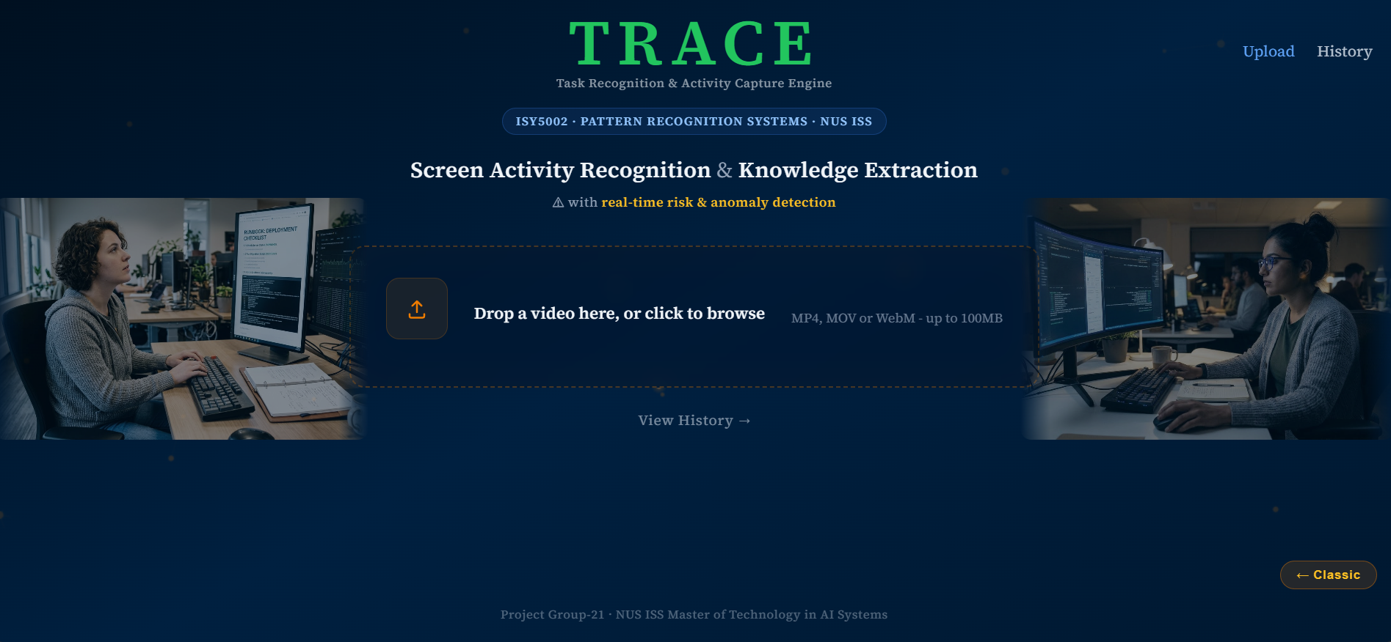

Slide 37
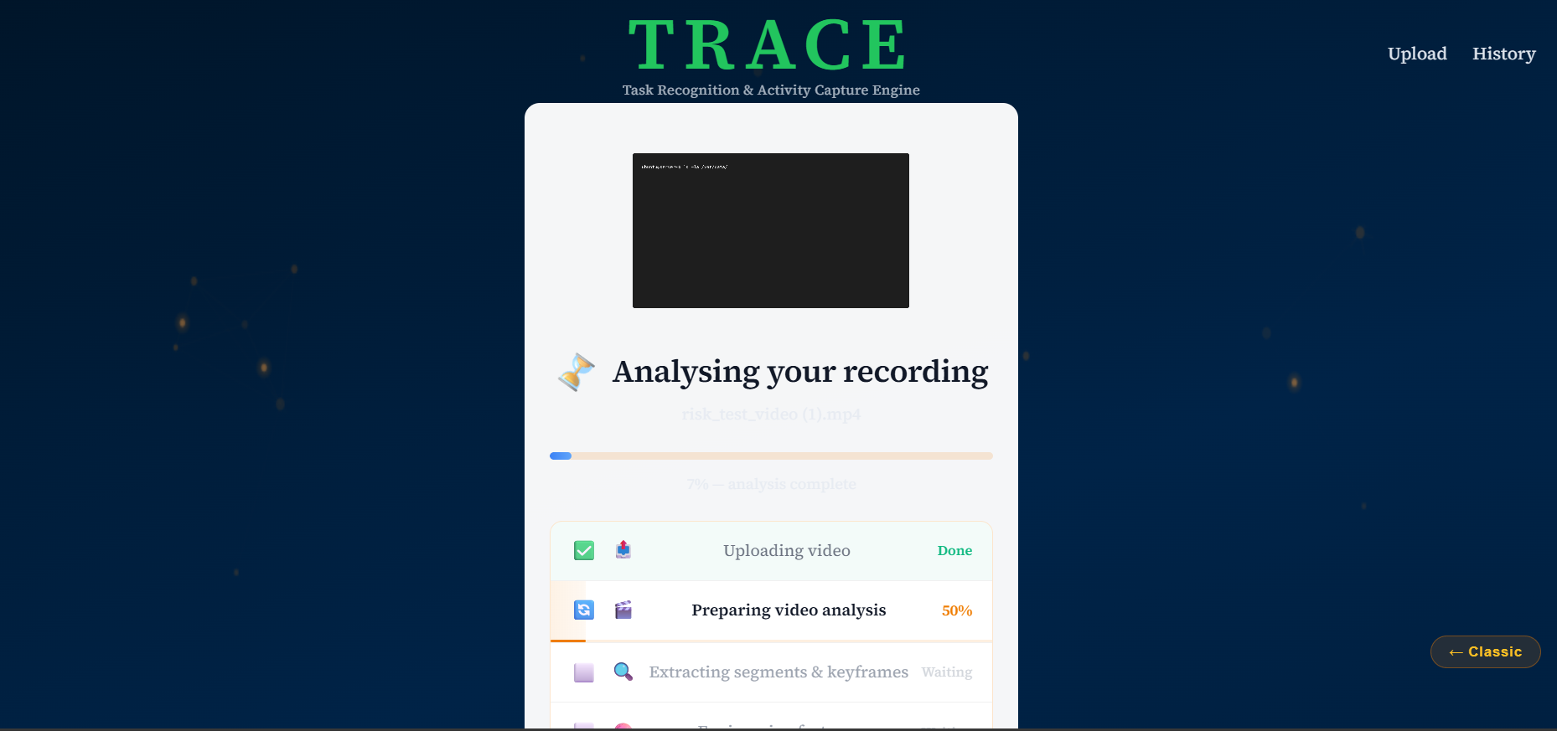

Slide 38
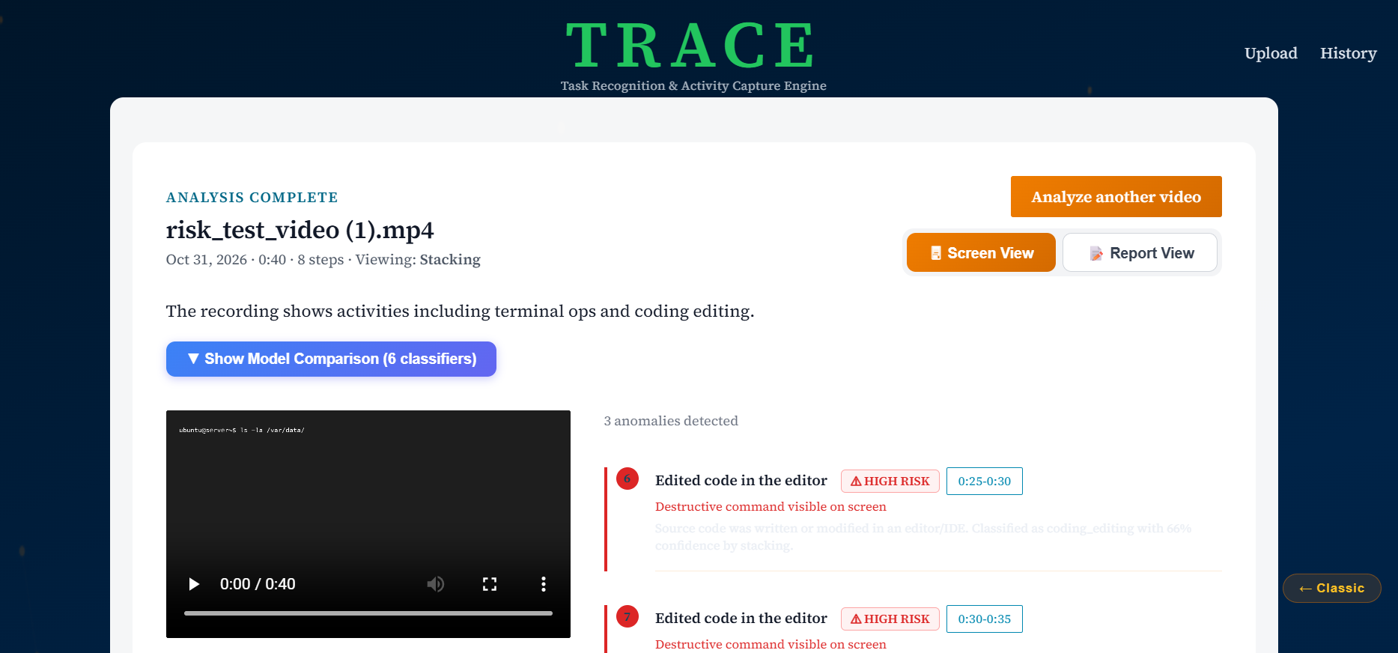

Slide 39
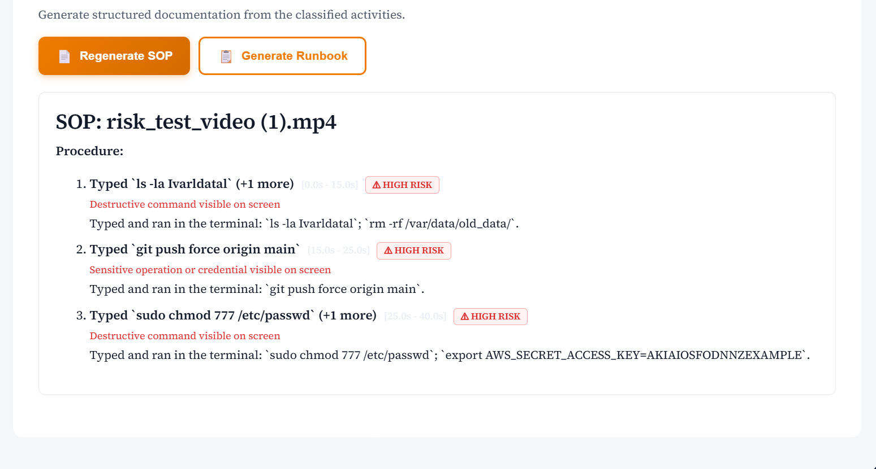

Slide 40
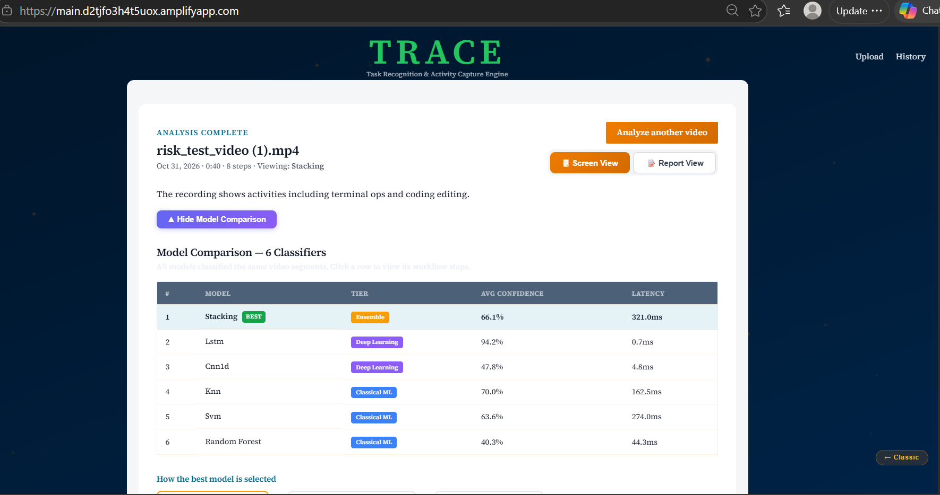

Slide 41
Challenges & Solutions
Large Dataset (48 GB)
Cannot fit in memory or train locally
Streaming dataset loader; AWS EC2 for cloud training; Google Colab as free alternative . In any case it is taking 12-15 hours of training time.
The dataset gave no activity labels. The activity field was null in all 4,963 rows, so the team had to write its own app-to-activity mapping. The first version left 72% of samples as "other". Refining the mapping brought that to about 15%, and v3's 130+ mappings and 4 new classes brought it under 1%.
No activity class in Dataset
Retraining the models again and again which took lot of time.Evry run is around 10-12 hours
OCR output is not correct
EasyOCR or Tesseract) are trained on scanned documents (with plain backgrounds and uniform black text). On complex user interfaces with multiple panels, overlapping windows, gradients, or custom font anti-aliasing, the OCR engine struggles to achieve high certainty,
Screen OCR is often noisy, the model relies much more heavily on the visual features extracted via the CNN backend (EfficientNet-B0) and localized UI elements than it does on raw parsed OCR text strings.
Stratified train/test split; 5x augmentation for datasets < 100 samples; F1-macro as primary metric
Class Imbalance
Uneven activity label distribution. Heavy class imbalance. VSCode and OpenShot make up about 65% of the 277 local tasks. We used macro-F1 and stratified splits instead of plain accuracy.

Slide 42
The duplicate-frame check compared whole-screen averages, so a new terminal line went unnoticed. risk_test_video.mp4 was read on only 2 of 24 keyframes. The check now counts changed pixels.Tesseract was dropped. It did worse than EasyOCR on terminal text.
Missed screen changes.
a CPU-only image, SQLite inside the task (so only one running task), cold starts, and the first job downloading CNN weights. Fixes were baking the weights into the image, a startup warm-up, and a feature cache keyed by the video's hash
Fargate constraints:
For a live demo. This was addressed by sharing one EasyOCR reader across jobs, batching OCR, reusing text for unchanged frames, caching features by video hash, and pre-warming the demo videos.
Slow Analysis

Slide 43
Future Work
RAG Pipeline
Add retrieval-augmented generation for knowledge extraction from classified video segments
MLflow Integration
Experiment tracking, model versioning, and automated model selection. Currently we have to upload our models in S3 manually and provide a different location everytime. We can make this pipeline automated.
GPU Optimization
CUDA-accelerated inference for real-time video analysis
Additional Datasets
Extend beyond CUA-Suite to cover more diverse screen activity patterns. Current dataset is very constrained and to train some specific cases we need to feed them those vides i.e AWS , Azure , cloud platforms . Then other apps which are very common
Enhance SOP detector and OCR
We need to enhance the SOP detector to create better polish SOP along with better OCR reading . Currently due to screen reading the OCR is not upto the mark as Easy OCR reads scanned document better than screen .

Slide 44

THANK YOU
M.Tech in Artificial Intelligence Systems
National University of Singapore
Pattern Recognition Systems | September 2026
github.com/laxmi1707/PatternRecognSystem-Video2Text

Slide 45
Annex
Declaration of References & AI Usage
In accordance with academic and professional guidelines, we declare that the background research, market context, and this project are grounded to use the dataset from hugging face.
Generative AI Disclosure: In accordance with academic guidelines, we disclose that Google Gemini, ChatGPT T5, Claude sonnet 5 was utilized as a collaborative advisor to structure the project documentation and brainstorm Singapore-specific use cases. All outputs were reviewed and validated by the group members for technical accuracy.

